Slide 1


Which outcomes of self-management matter to patients, family/carers, health professionals and commissioners?
Dr Sara Demain, Associate Professor

Slide 2
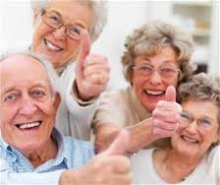
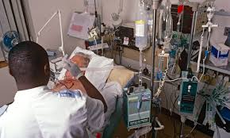

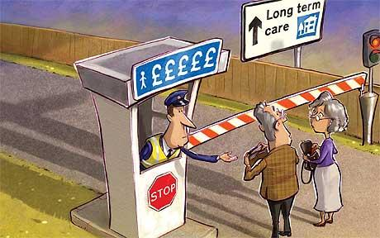
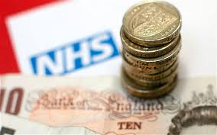
Notes:
Ageing population, living well for longer
15 million people in England live a LTC
Increasingly more complex health care
15 million with LTC in UK
70% health and social care
£ 2bn deficit in NHS 2015
£2bn pound deficit NHS (March 2015)

Slide 3

Self-management and “patient empowerment”

Slide 4
Self-Management
What is it?
“individuals making the most of their lives, coping with difficulties and making the most of what they have.
It includes managing or minimising the way conditions limit individuals’ lives
as well as what they can do to feel happy and fulfilled, to make the most of their lives despite the condition.”
(Department of Health, 2008)

Slide 5
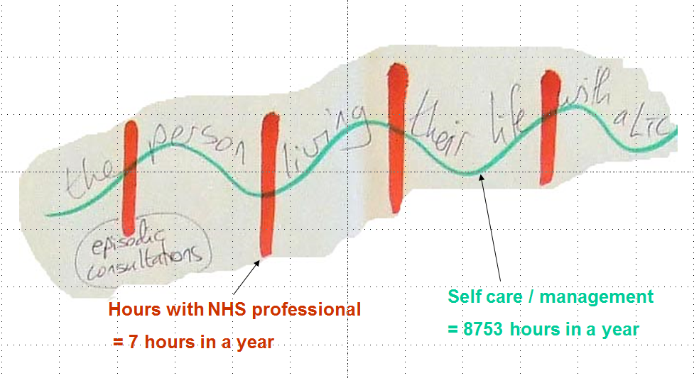
What outcomes matter
  People with LTCs
  Families and friends
  Health professionals

Slide 6

Self-management:
Why bother?
Better health?
Happier patients?
Lower costs?
Panacea or snake-oil?

Slide 7
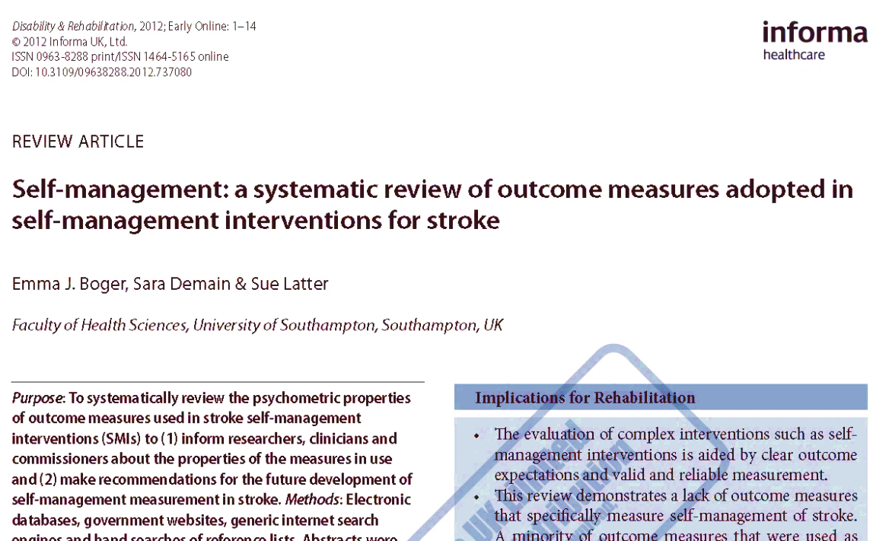
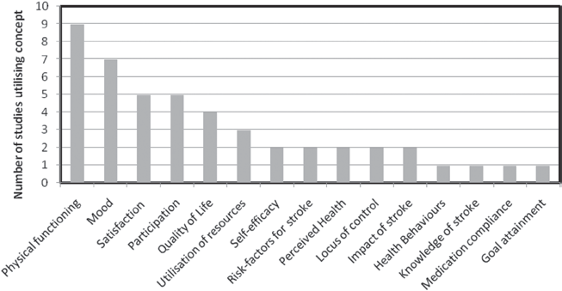
Self-management:
What’s it for?
  Stroke self-management
  13 trials of Stroke SM
  15 concepts measured
  43 outcome measures
  Mostly “clinical”

Slide 8

SM: VOICED Study
Self-Management: Valued Outcomes; Investigating ConsEnsus and Difference
http://www.southampton.ac.uk/smvoiced/index.page
@ SMVOICED

Slide 9
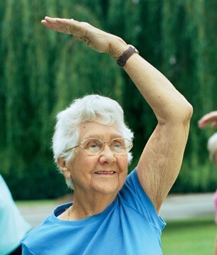



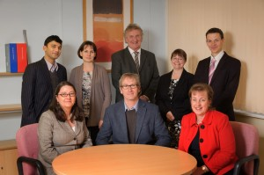
Effective Self-management

Slide 10
Aims
To understand-
What outcomes each stakeholder wants SM to achieve?
How they would recognise successful SM and successful SM support?
Identify consensus and disparity

Slide 11
Methods
Phase 1 – Systematic review.
  Boger et al; PLOS-One.
Phase 2 – Qualitative data gathering
Phase 3 - Delphi

Slide 12
Methods
3 conditions: diabetes, stroke, colorectal cancer
3 centres: Southampton; Leeds; London + 50 mile radius (urban and rural)
+ NHS England commissioning policy makers

Slide 13
Methods
Focus groups and interviews
People’s understanding of:
  SM and SM support
  desired outcomes
  what was the point of SM? What would constitute a good / bad ‘self-manager’? How could SM support be evaluated?
Deductive thematic analysis - coding schema developed from SR

Slide 14
Sample (n= 166)
89 people with LTC
  Diabetes (38); Colorectal Cancer (19); Stroke (40)
35 friends and family
  Diabetes (14); Colorectal cancer (10); Stroke (11)
20 HCP
  Diabetes (3); Colorectal cancer (3); Stroke (6); Generic (8)
22 Commissioners
  CCG (17); CSU (1) NHS England (4)
Notes:
31% male; 83.5% patient and FF white British;

Slide 15
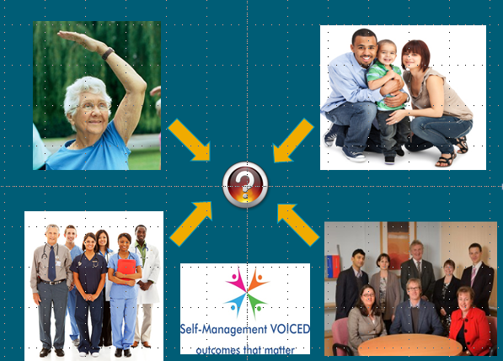
Findings

Slide 16
Commissioners
Focus on process measures & healthcare utilisation
  ‘’ the economic impact looking at the emergency admission rate, bed days, [impact on] ambulatory care services, emergency admissions, emergency readmissions, rehabilitation, residential home…..’’ (comm 11)
Focus on patient responsibility
  ‘’I think we have gone far too much down the path of the nanny state, where everything is done for people, and I think we are trying to bring it back to a point where patients have to realise that actually ultimately they are the ones that control their lives’’ (comm 20)

Slide 17
Commissioners
Also value person centred care and ‘soft’ outcomes – confidence, wellbeing, etc
The best outcome for me , [the] “Why are we doing it?” is that there’s an increase in terms of people feeling more supported and confident to manage their condition’’ (comm 17)
But don’t know how to measure these
‘Well because of the personalisation [agenda] now outcomes are difficult to measure because they’re personalised. So if somebody says, “I want to go fishing,” well how do you measure that [or] if somebody wants to start knitting? You can’t’’. (comm 10)

Slide 18
HCP
Biomarkers are important measures of health and compliance
  at a rather narrow level, you can look at their biochemical parameters, so we’ve got the measures of blood glucose which – HBa1C,…you can tell whether they’re taking their cholesterol medications, you can look at their blood pressure, you can look at their weight. And those are very important end points. They’re not really – they’re not the whole story at all’’ (HCP, DM)
Driven by government and commissioning targets and clinical guidelines

Slide 19

Targets can hinder person centred outcomes
I’ve got one person with diabetes who refused to be weighed but... it’s not about it being my target, it’s about that person and how do we deal with that issue,...
…And then there’s the feeling that we’ve become ‘our income is dependent on achieving those targets’, so that’s produced another feeling, and dynamic.”

Slide 20
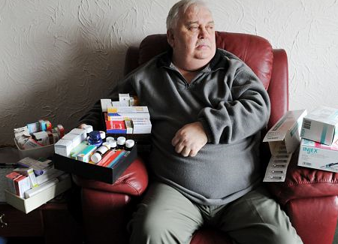
Patient choice and control
he said he didn't even want to take any of his drugs. So I said, "Right, let's take you off your drugs then." Because he probably wasn't taking them at home; he didn't want to take them. He's just emptying them.
And then once we got back to basics I said, "What would you be willing to take?" So he told me what he was willing to take, so I prescribed that and we gradually got him back on all his drugs and his diabetes was really well controlled within a year”

Slide 21
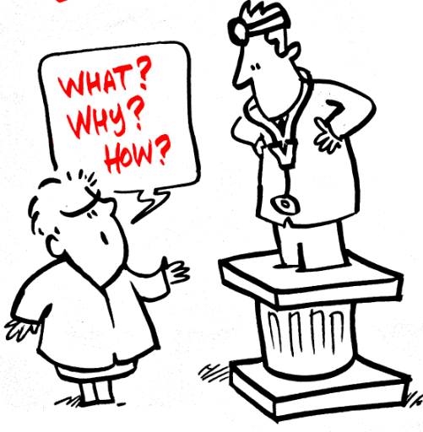
Patients and families
Want more support, information and tailored advice
HCP need to take responsibility for SM too
Families - how to get patients to do what they should.
Patients – how to adapt treatments to live well and feel normal

Slide 22
’without the help I haven’t got a clue and that went on for years …… because I just couldn’t and nobody was telling me anything useful that was actually practical and fitted in with a life; that you could sustain ongoing, yes you could do it for a month or two but then actually, I have got a life!! (patient)

Slide 23
Nick’s self- management wish-list….
I don’t want to be blamed or dictated with a broken record,
I want the professionals to be listening and learning from me, to feel like I’m listened to and involved and that my experience and knowledge has some value and respect, not that I’m right, but that they’ll listen to it.
And that the people I’m talking to understand the challenges that we’ve got, that it’s ‘not just that easy; that it is difficult’
and that they give us options and flexible responses, and not just the same old thing, kind of, “Go back and do it again”.
And the thing that matters most to me, that’s crucial to me, is to feel that what I’m doing makes a difference because if I don’t feel it makes a difference I won’t do it. I can’t sustain doing it for decades unless I know it makes a difference.

Slide 24
Summary
Complex range of outcomes - often in tension
Biological health
Living well
Being responsible
Being supported
Achieving targets
Person centred care
compliance
patients in control

Slide 25


Slide 26
Next steps…
National Delphi survey:
Identifying outcome priorities for stakeholders
Stakeholder events – discuss tensions and ways forward
Work on measurement and evaluation of SM

Slide 27
  Patient and family views priority

Slide 28
Self-Management VOICED Study
Website:
www.southampton.ac.uk/smvoiced
Twitter:
@SMVOICED
Email:
S.H.Demain@soton.ac.uk
HSRN Posters: 59 and 60

